Slide 1

Project on
Cryptocurrency Price Prediction using
Machine Learning using python
Presented by
Kali. Sirichandana
Songa. Devi
Manimela. Dinesh Kumar
Mannam. Satish

Slide 2
Objective:
This project aims to develop a machine learning-based system for Bitcoin price prediction using historical data and technical indicators like Moving Averages, RSI, and MACD. Models such as Linear Regression and Random Forest will be implemented and evaluated using metrics like MSE, RMSE, and R² Score to determine the most accurate approach. The goal is to provide data-driven insights for traders and investors, helping them make informed decisions. Additionally, the system is designed to be adaptive and scalable, allowing continuous updates and potential expansion to other cryptocurrencies.
Cryptocurrency price prediction using Machine Learning with python

Slide 3
Cryptocurrency price prediction is a challenging task due to the high volatility and complex market dynamics. This project explores the use of machine learning techniques to forecast cryptocurrency prices based on historical data, technical indicators. Various models, including Linear Regression, Random Forest are implemented and evaluated for their predictive accuracy. The results demonstrate the effectiveness of machine learning in identifying trends and patterns, providing valuable insights for traders and investors.
Cryptocurrency price prediction using Machine Learning with python

Slide 4
Cryptocurrency price predictions mainly rely on traditional statistical models and manual technical analysis.
High market volatility and external factors like news, regulations, and market sentiment make predictions less reliable.
Traditional models struggle to capture the complex, non-linear nature of cryptocurrency price movements.
Many existing approaches lack adaptability, leading to inconsistent and less accurate forecasts.
The absence of real-time data integration limits their effectiveness for timely decision-making.
Cryptocurrency price prediction using Machine Learning with python
Existing System:

Slide 5
Implementing advanced machine learning models such as Linear Regression, Random Forest and deep learning techniques for improve accuracy.
Leverage historical Bitcoin data and key technical indicators for feature engineering and pattern recognition.
Compare and optimize multiple models using performance metrics(MSE,RMSE, R² Score)to identify the most robust and reliable approach.
Develop an Adaptive and scalable predictive framework that continuously updates with new data, enhancing real-time decision-making for traders and investors.
Cryptocurrency price prediction using Machine Learning with python
Proposed System:

Slide 6
Software Requirements:
Python, Jupiter Notebook
Libraries: NumPy, Pandas, Scikit-learn
Data sources: Coin Gecko, Kaggle datasets
Hardware Requirements:
Input Device: keyboard, Mouse
System:i5 processor
Hard Disk:512GB
Ram: 8GB
Cryptocurrency price prediction using Machine Learning with python

Slide 7
Functional Requirements:
Data collection and preprocessing
Implementation of machine learning models
Model evaluation and accuracy measurement
Non-Functional Requirements:
Accuracy: Aim for a high R² score and low RMSE
Performance: Fast and efficient model training and inference
Scalability: Should be extendable to multiple cryptocurrencies
Cryptocurrency price prediction using Machine Learning with python

Slide 8
Drawbacks of the System:
Cryptocurrency markets are highly unpredictable, and no model can guarantee 100% accuracy.
External factors like government regulations, market manipulation, and sudden news events can impact predictions.
Machine learning models require continuous updating with fresh data.
Cryptocurrency price prediction using Machine Learning with python

Slide 9
Advantages of the System:
Provides a data-driven approach for crypto price forecasting.
Helps traders and investors make informed decisions.
Can improve over time with more data and better algorithms.
Reduces reliance on purely manual analysis, increasing efficiency.
Cryptocurrency price prediction using Machine Learning with python

Slide 10
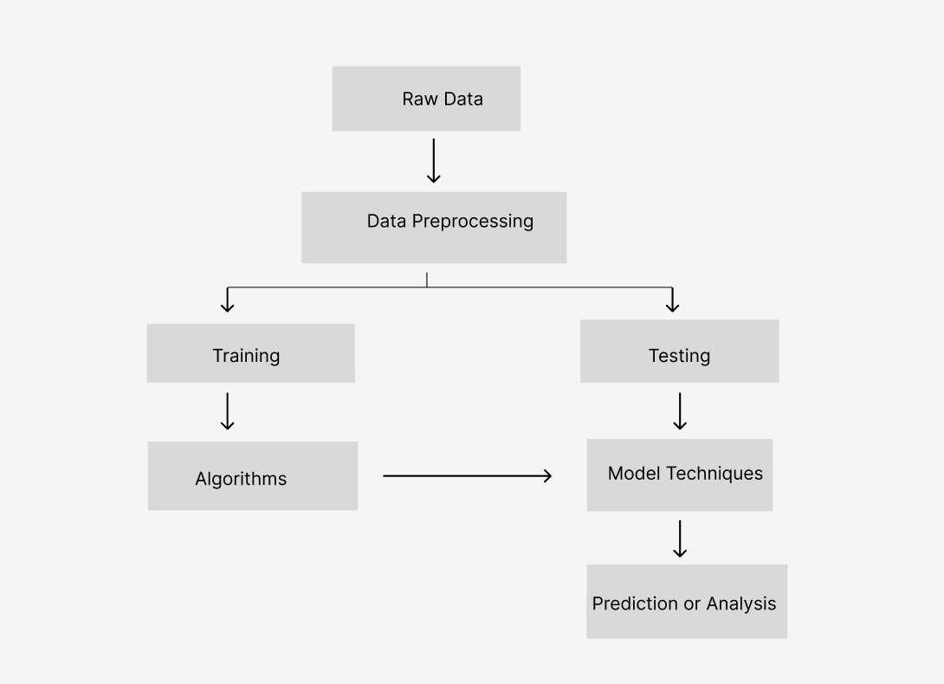

Slide 11
Raw Data – Collects the initial dataset for analysis.
Data Preprocessing – Cleans, transforms, and prepares data for modeling.
Training – Uses processed data to train machine learning models.
Algorithms – Applies various ML algorithms to learn patterns.
Testing – Evaluates the trained model on unseen data.
Model Techniques – Uses evaluation techniques to assess performance.
Prediction or Analysis – Generates predictions or insights based on the trained model.

Slide 12
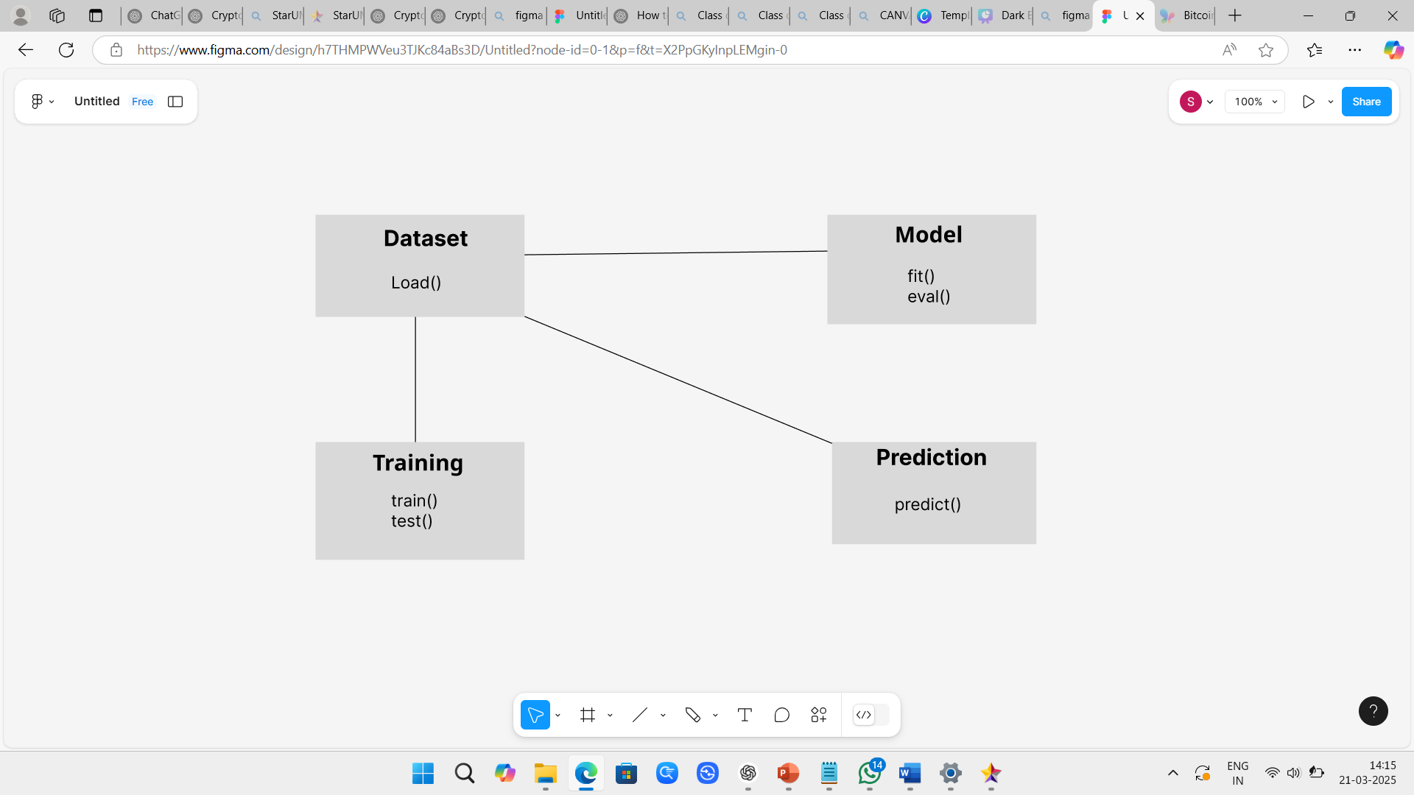

Slide 13
Dataset – The collection of raw data used for training and testing the model. 2
Training – Dataset is used to evaluate model performance.
3. Model – The machine learning model that learns patterns from the training data.
4. Prediction – The final output or forecast generated by the model based on the input features.

Slide 14
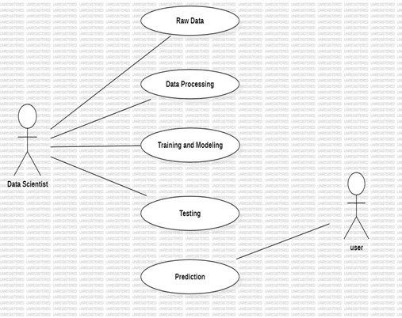

Slide 15
Raw Data – The data scientist collects historical Bitcoin price data and market indicators.
Data Processing – The raw data is cleaned, normalized, and transformed for analysis.
Training and Modeling – Machine learning models are trained using the processed data.
Testing – The trained model is evaluated for accuracy and performance using test data.
Prediction – The final model predicts Bitcoin’s closing price, which is accessed by the user.

Slide 16
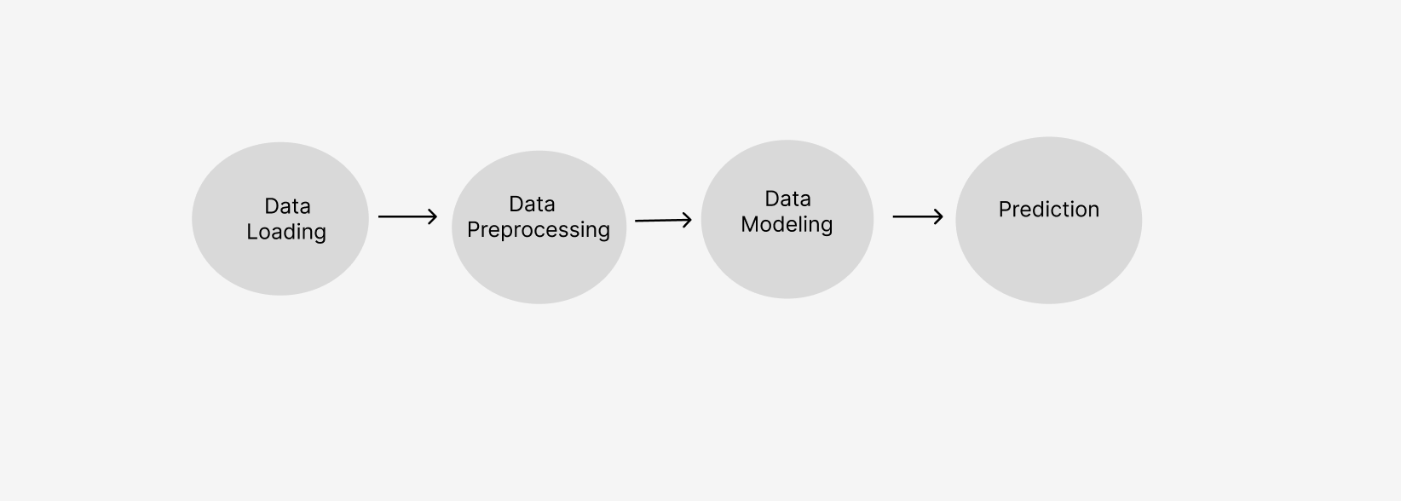

Slide 17
1. Data Loading:
Historical Bitcoin price data is collected from sources such as APIs or CSV files.
Data Preprocessing:
The raw data is cleaned, normalized, and transformed for better model performance.
Data Modeling:
Machine learning models are trained on the processed data to learn patterns.
Prediction:
The trained model predicts the closing price of Bitcoin based on input features.

Slide 18
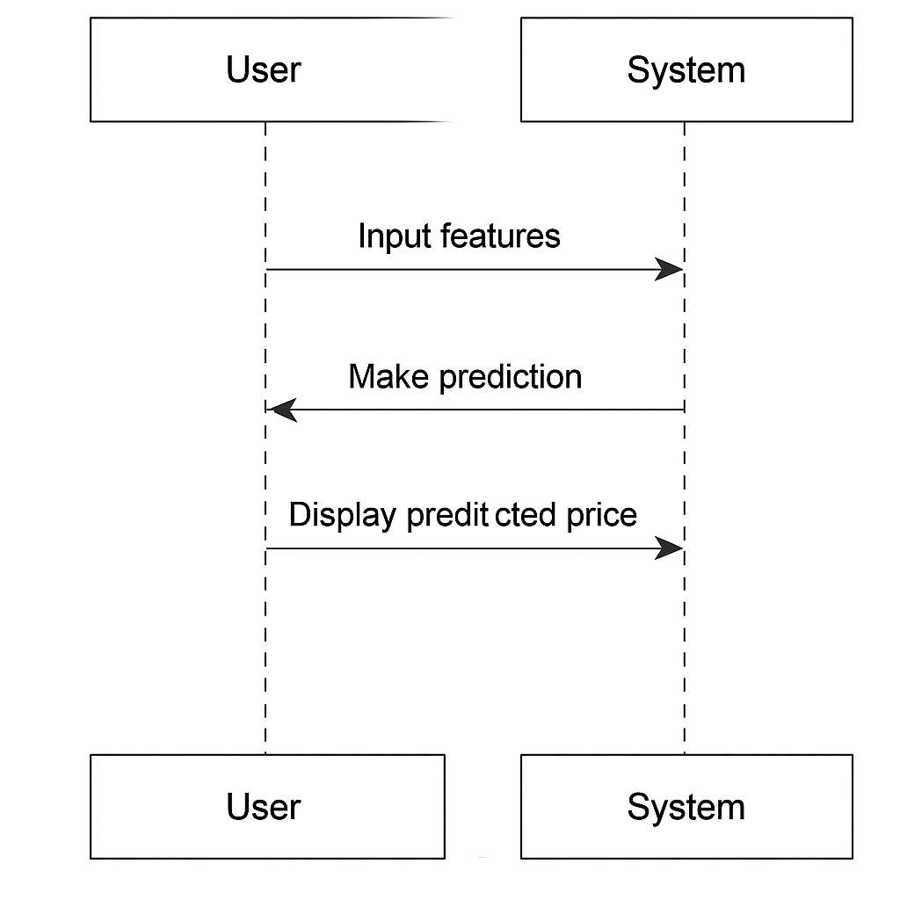

Slide 19
SEQUENCE DIAGRAM
User → System: Input features – The user provides input data (features) to the system.
System → User: Make prediction – The system processes the input and makes a prediction.
User ← System: Display predicted price – The system sends back and shows the predicted price to the user.

Slide 20
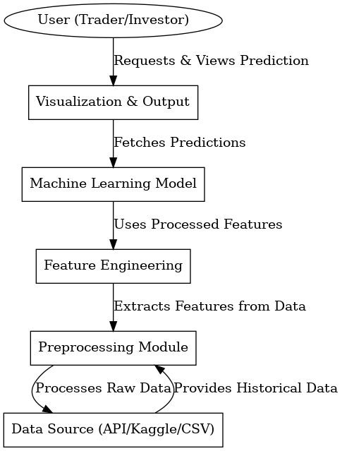

Slide 21
COLLABORATION DIAGRAM
User asks for a prediction.
The system shows the result using charts or text.
A machine learning model makes the prediction.
It uses features created from clean data.
Raw data is collected from sources like APIs or CSV files.
That data goes through preprocessing and feature engineering before being used by the model.

Slide 22
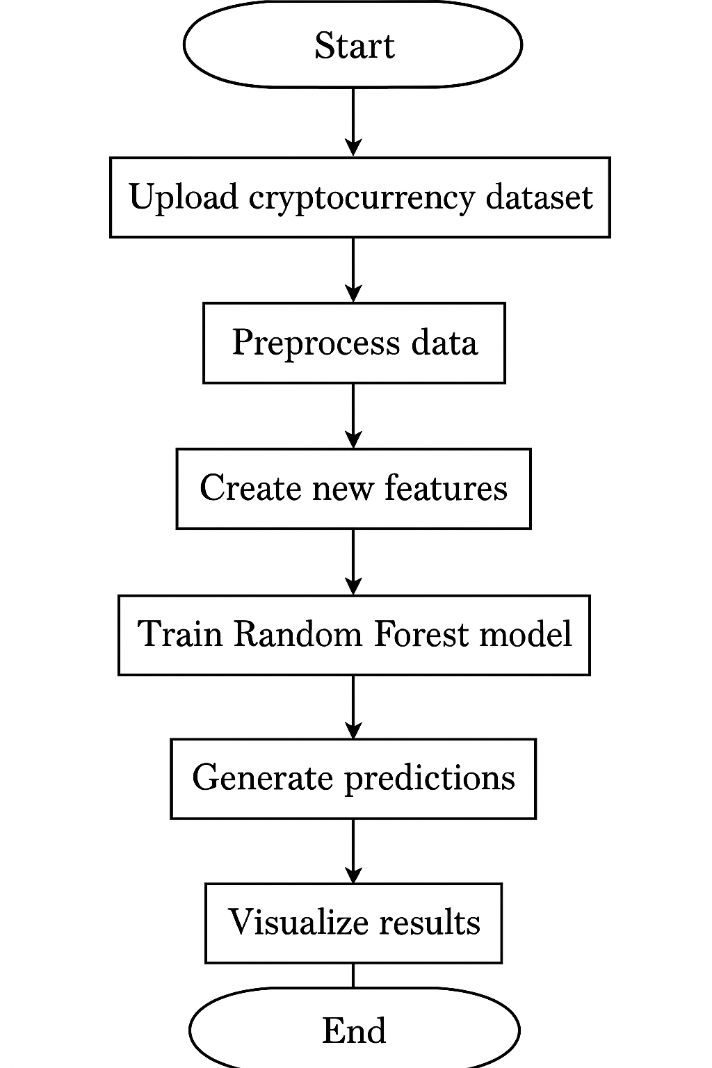

Slide 23
ACTIVITY DIAGRAM
Start – Begin the prediction process.
Upload cryptocurrency dataset – Add your crypto data file to the system.
Preprocess data – Clean and format the data so it's ready to use.
Create new features – Add useful information (like trends or averages) to help the model.
Train Random Forest model – Teach the model using the data and features.
Generate predictions – Use the trained model to predict future prices or trends.
Visualize results – Show the predictions using graphs or charts.
End – The process is complete.

Slide 24
Coding and EXECUTION
Python – Core programming language
Pandas & NumPy – For data handling and processing
Scikit-learn – ML models, scaling, and evaluation
XGBoost – Extra model for better prediction
Streamlit – Builds the interactive web app
Matplotlib – For charts and visualizations
RandomizedSearchCV – Model tuning
MinMaxScaler – Normalizes data
CSV Export – Downloads predictions easily

Slide 25
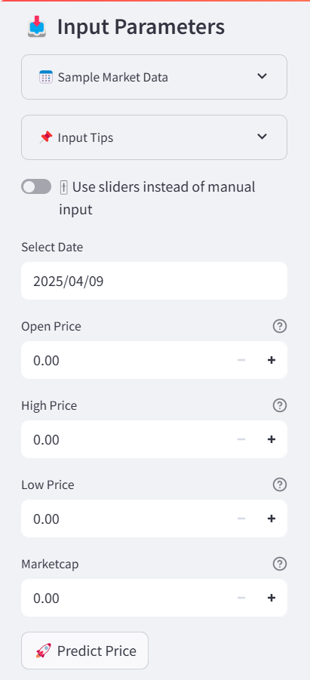
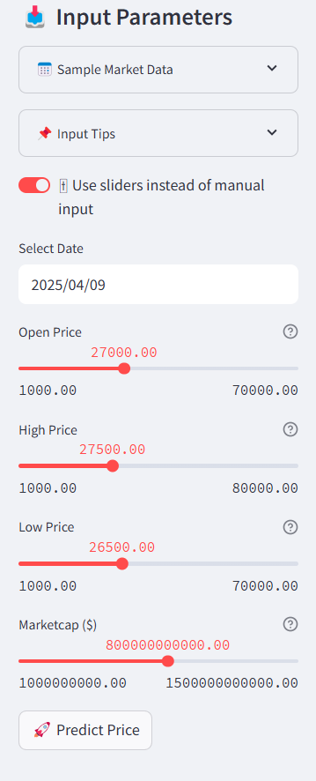

Slide 26
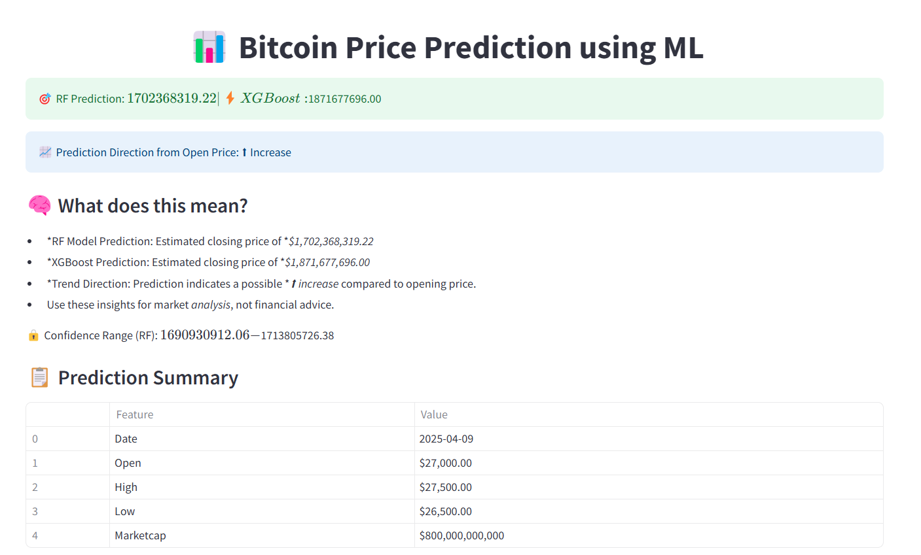

Slide 27
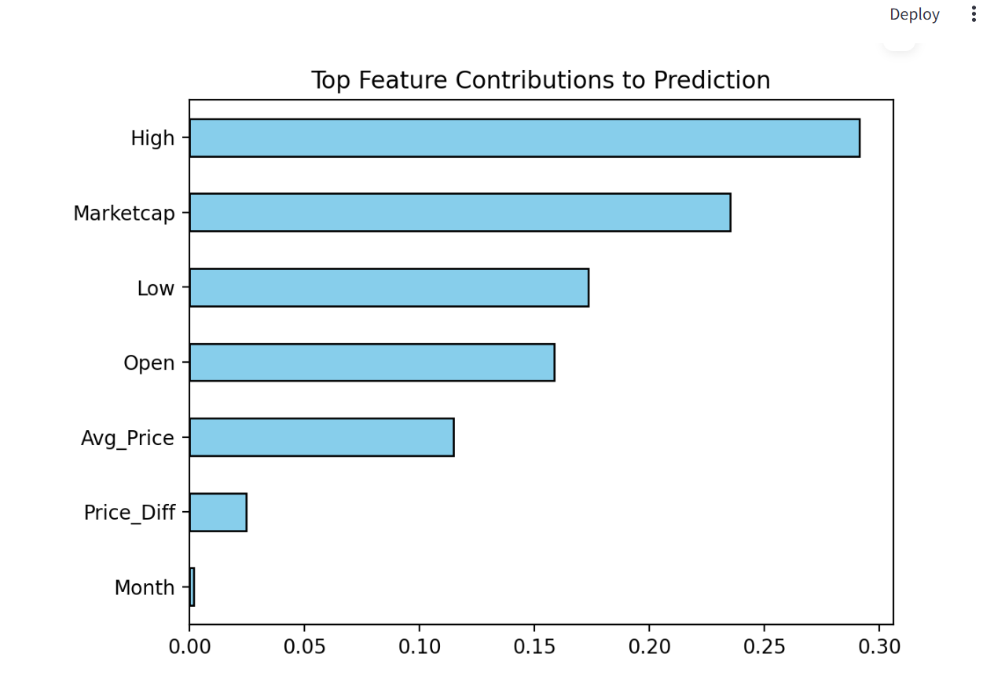

Slide 28
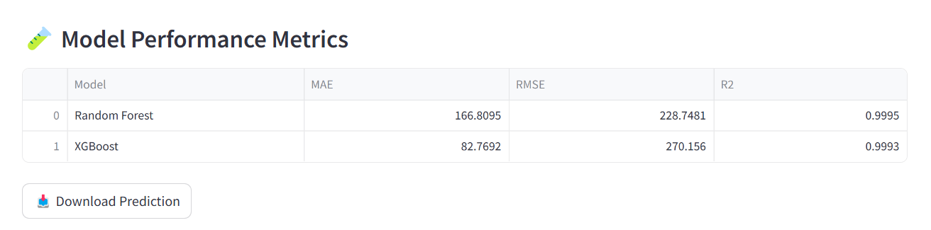

Slide 29
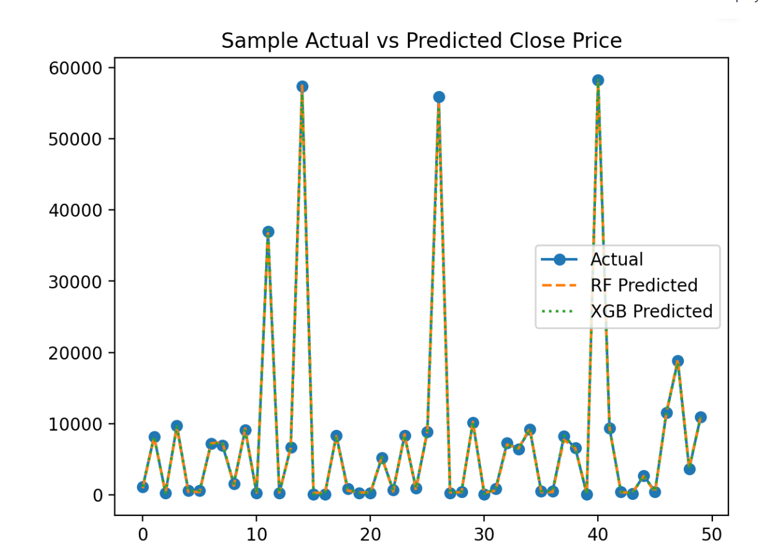

Slide 30
thank YOU

